Slide 1

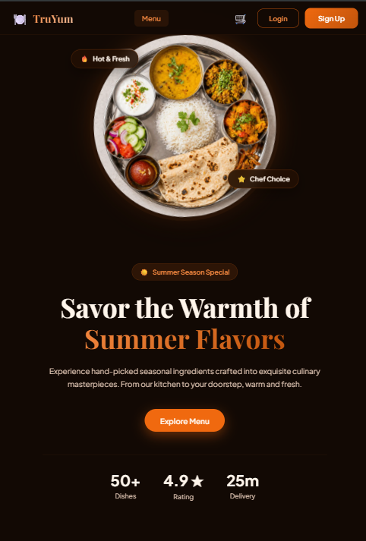
WIPRO NGA Program – 26SUB0576_NMS Test
Capstone Project Presentation – 13th June 2026
TruYum
Premium Full-Stack Food Ordering & Restaurant Management System
Presented by Swayam Gupta
www.rpsconsulting.in

Slide 2

Problem Statement
Modern food delivery applications often face critical challenges that impact both users and businesses:
Poor User Experience
Clunky interfaces and slow navigation frustrate customers
TruYum Mission
To build an enterprise-ready, dark-themed gourmet food delivery app with instantaneous user feedback, smooth user journeys, and full-scale admin controls.
Inefficient Order Management
Manual processes lead to errors and delays in fulfillment
Lack of Real-Time Feedback
Users are left uninformed about order status changes
Target Audience
Gourmet customers looking for premium food options, and restaurant admin’s looking to oversee menu items, orders, and sales stats.
Limited Administrative Control
Admins lack tools to manage menus, orders, and analytics
2026 - RPS Consulting all rights reserved
2

Slide 3
Objectives
Seamless Ordering
Secure Authentication
Restaurant Management
Provide a smooth and intuitive food ordering experience for gourmet customers
Enable OTP-based secure login and role-based access control for all users
Simplify menu, order, and sales management for restaurant administrators
Real-Time Feedback
Scalable Architecture
Offer instantaneous toast notifications and order status updates to users
Maintain a robust MEAN stack architecture capable of handling growing demand
2026 - RPS Consulting all rights reserved
3

Slide 4
Technology Stack
Frontend
Backend
Angular with modern architecture:
Standalone Components
Signals for state management
Reactive Forms & Router
RxJS & HttpClient
Node.js & Express.js REST APIs:
Mongoose ODM for MongoDB
JWT Authentication
Multer for image uploads
Bcrypt.js for password hashing
Database
Development Tools
MongoDB NoSQL Document Store:
Flexible schema design
Localized clusters
High performance queries
VS Code
Git / GitHub
Postman
MongoDB Compass
Node Package Manager (NPM)
2026 - RPS Consulting all rights reserved
4

Slide 5
System Architecture
TruYum follows a modern 3-tier client-server architecture with clear separation of concerns
Customer
HTTP
Angular Frontend
JSON
REST API
CRUD Ops
Express Server
Queries
MongoDB
2026 - RPS Consulting all rights reserved
5

Slide 6
Requirements & User Roles
Customer / End-User Role
Administrator Role
Browse & Discover
Browse gourmet categories and food items with rich visuals
Search & Filter
Search menu and filter items by Vegetarian, High-rated, Free Delivery
Cart Management
Add/remove items with dynamic delivery charge calculation
Secure Checkout
OTP-based login and saved address selection at checkout
Reviews & Ratings
Write star ratings and review comments on food details
Sales Dashboard
View metrics: Revenue, Total Orders, Status Breakdown
Menu Management
Add & Edit food items with seamless image uploading
Stock Control
Mark items In-Stock or Out-of-Stock with dynamic grey-out
Order Tracking
Update order delivery progress and payment statuses
2026 - RPS Consulting all rights reserved
6

Slide 7
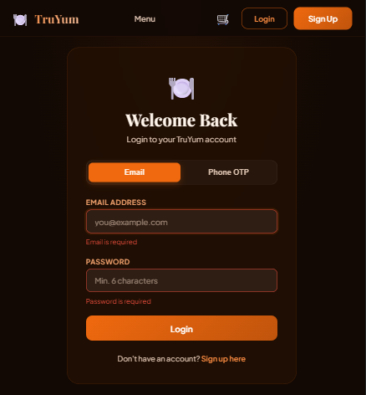
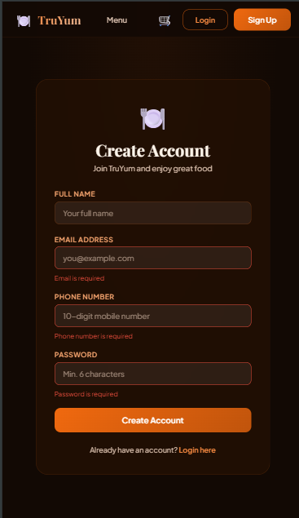

Slide 8
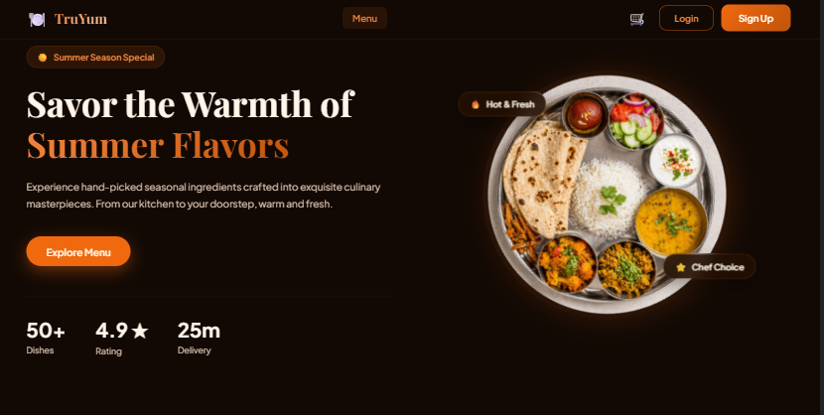

Slide 9
MongoDB Collection Layout
TruYum uses 5 core collections designed for scalability and performance
users
foods
categories
Stores user credentials, roles (CUSTOMER or ADMIN), phone numbers, and arrays of nested addresses.
Stores gourmet details, rating metrics, launch dates, active stock flags, and nested reviews array.
Stores dynamic category cards with name and image URL for menu organization.
orders
otps
Stores order details, selected delivery address, item totals, payment status, and delivery progress tracking.
Stores verification codes linked to phone numbers with an expiration index for automatic cleanup.
2026 - RPS Consulting all rights reserved
7

Slide 10
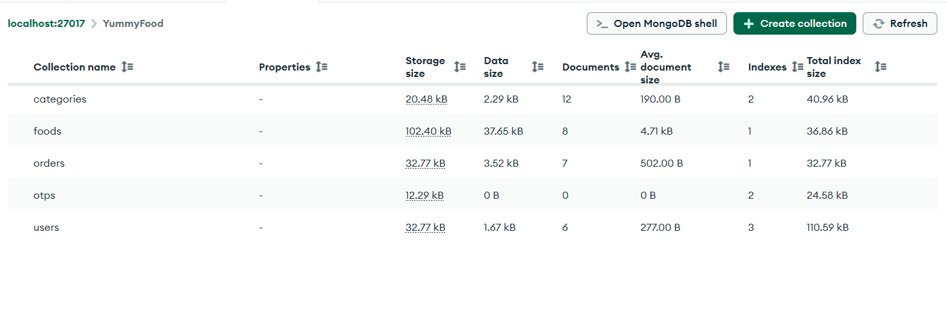

Slide 11
Key Enterprise Features
Advanced features that make TruYum stand out as an enterprise-grade application
Angular Signals
Global Error Interceptor
Reactive state management with fine-grained reactivity for optimal performance
Centralized error handling ensuring consistent user experience across the app
JWT Authentication
SEO Friendly URLs
Secure token-based authentication with protected routes and session management
Clean, descriptive URLs for better search engine discoverability and ranking
Skeleton Loaders
Role Based Authorization
Smooth loading placeholders that enhance perceived performance during data fetch
Granular access control distinguishing Customer and Admin privileges securely
Toast Notifications
Real-time user feedback for actions like add-to-cart, order placement, and status updates
2026 - RPS Consulting all rights reserved
8

Slide 12
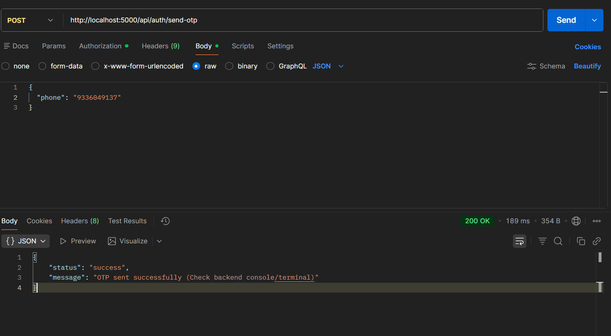

Slide 13
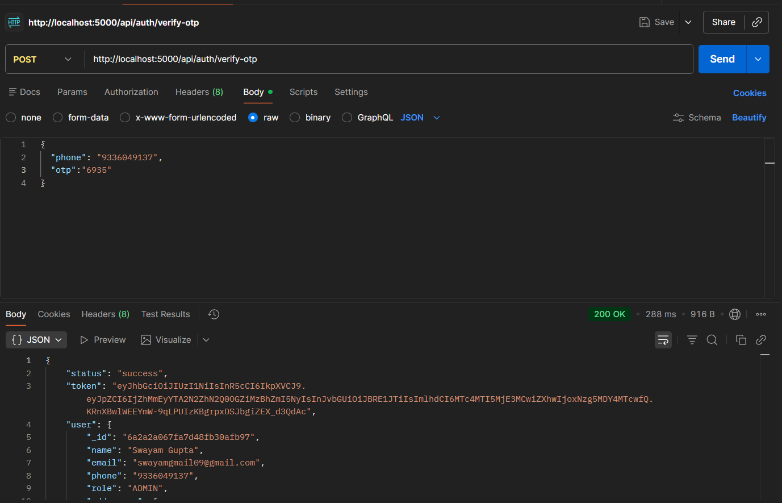

Slide 14
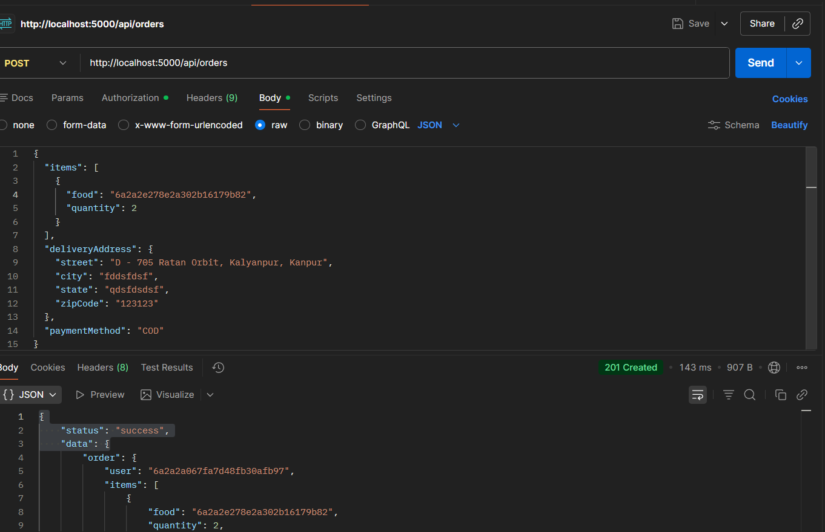

Slide 15
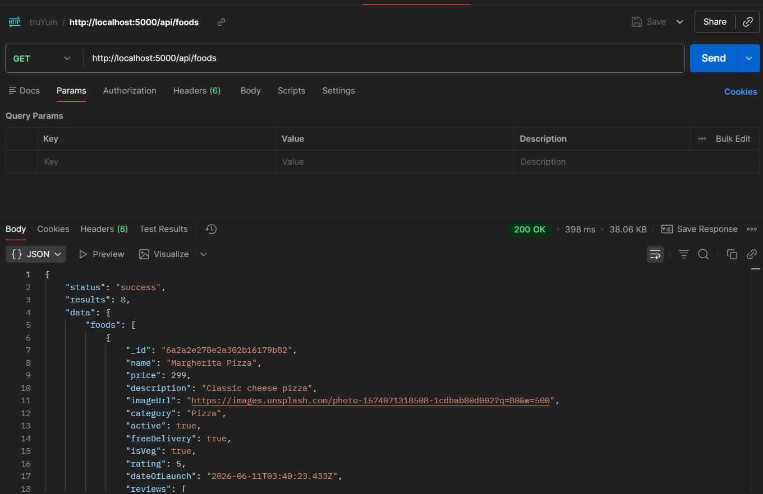

Slide 16
Demo Flow
Complete application workflow from admin setup to order fulfillment
Admin Login
Add Food
User Registration
Browse Menu
Admin Updates Status
Place Order
Checkout
Add to Cart
Flow Description
1. Admin Login: Administrator authenticates to access the management dashboard
2. Add Food: Admin adds gourmet items with images, pricing, and categories
3. User Registration: New customer signs up with OTP-based phone verification
4. Browse Menu: Customer explores categories, applies filters, and views details
5. Add to Cart: Items added with dynamic delivery charge calculation
6. Checkout: Customer selects saved address and confirms the order
7. Place Order: Order is stored with full details and status tracking
8. Admin Updates: Admin updates delivery progress and payment status
2026 - RPS Consulting all rights reserved
9

Slide 17
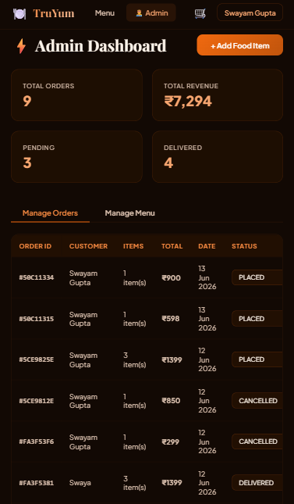
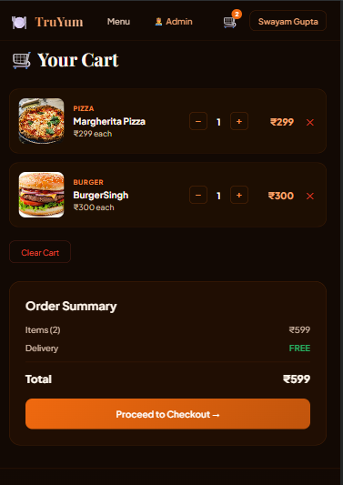
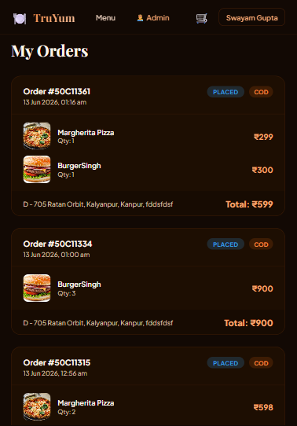

Slide 18
Challenges Faced
Real-world development challenges encountered and resolved during the project
JWT Authentication
Role Based Access
File Upload Handling
Implementing secure token generation, validation, and refresh mechanisms across the entire application stack.
Designing a flexible authorization system that securely distinguishes between customer and admin privileges.
Configuring Multer for secure image uploads with proper validation, storage, and retrieval of food item images.
Dynamic Cart Calculation
Error Handling
MongoDB Schema Design
Building real-time cart total computation with dynamic delivery charges based on order value and location.
Creating a global error interceptor that gracefully handles HTTP errors and provides meaningful user feedback.
Designing efficient document schemas with proper indexing, references, and nested structures for optimal queries.
2026 - RPS Consulting all rights reserved
10

Slide 19
Future Scope
Planned enhancements to make TruYum a production-ready platform
# | Feature | Description
1 | Payment Gateway | Integrate Stripe, Razorpay, or PayU for secure online payments with multiple payment methods
2 | Real-Time Tracking | Live order tracking with GPS integration for customers to monitor delivery progress on a map
3 | Cloud Storage | AWS S3 or Cloudinary integration for scalable, reliable image storage and CDN delivery
4 | SMS OTP | Twilio or MSG91 integration for reliable SMS-based OTP delivery and verification
5 | Advanced Analytics | Comprehensive reporting with sales trends, customer behavior insights, and predictive analytics
2026 - RPS Consulting all rights reserved
11

Slide 20
Conclusion
TruYum successfully demonstrates a scalable, secure and modern MEAN Stack application
capable of handling real-world food ordering
and restaurant management operations.
Angular + Node.js + Express.js + MongoDB | JWT Auth | Role-Based Access | REST APIs
Presented by Swayam Gupta
Thank You
www.rpsconsulting.in

